Slide 1


Capstone Project Report On “Salesforce application” “Travel App & Code Playground”
Name : P Rohith
Batch : WIP-SF-1
LMS ID : MGSA_498

Slide 2
Contents
Introduction
Module 1
Module 2
Module 3

Slide 3
Introduction :-
Salesforce CRM is a cloud-based platform which helps you to manage the sales, marketing, lead generation, customer service and many other functions.
Salesforce is secure, easy to use, and accessible anywhere.
You can easily manage and track all of your leads, contacts, opportunities, and accounts.
You can create custom reports to help you better understand your business data.
The main purpose of the platform is to enhance sales performance and provide better customer service

Slide 4
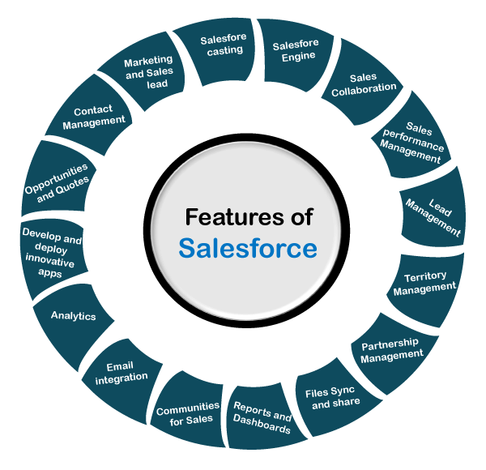

Slide 5
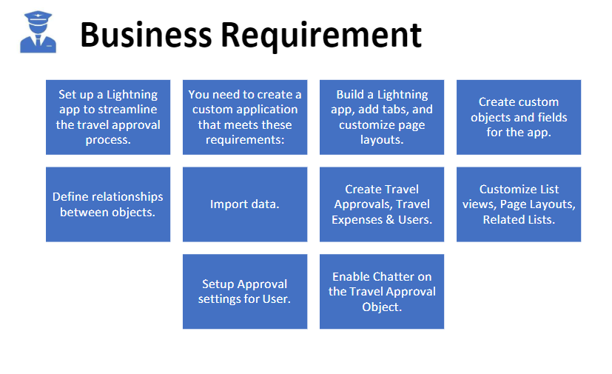
Module 1

Slide 6
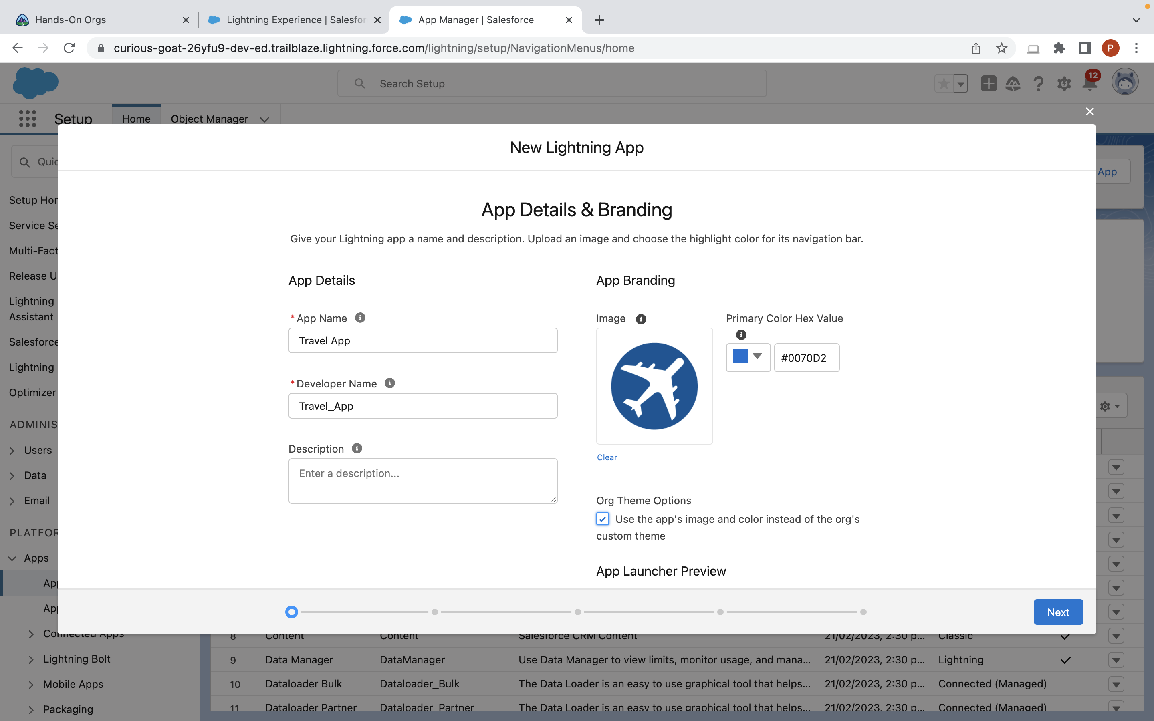

Slide 7
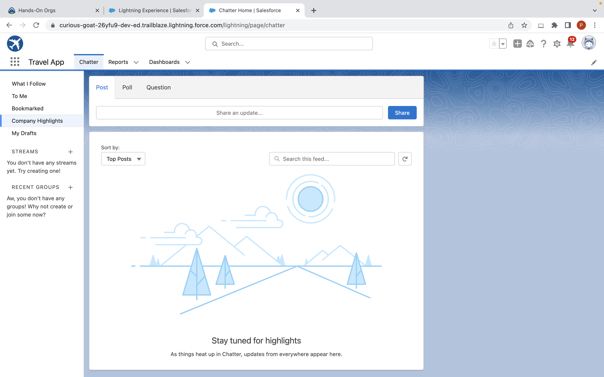

Slide 8
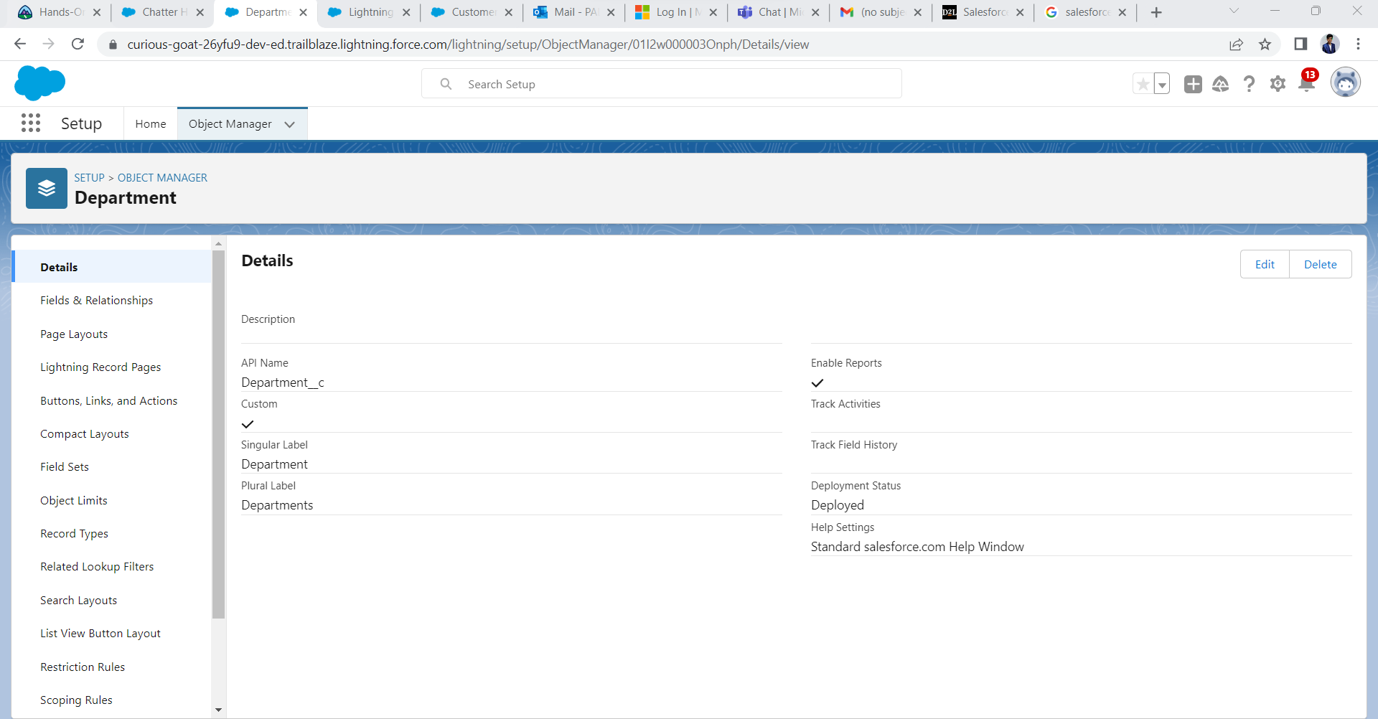

Slide 9
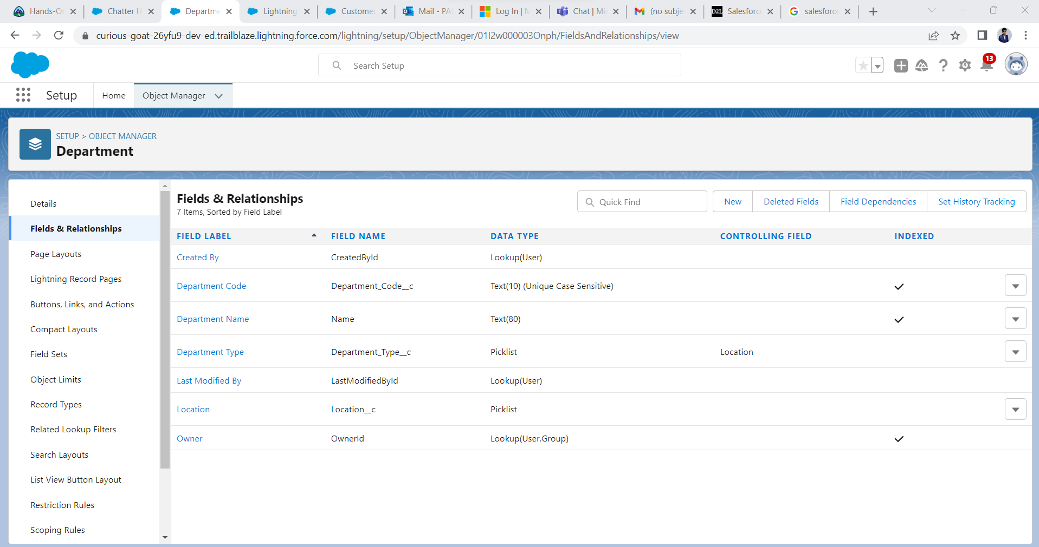

Slide 10
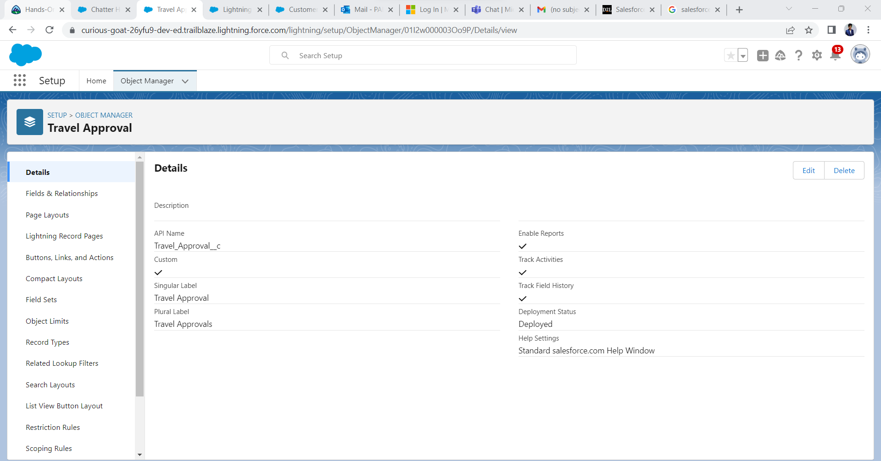

Slide 11
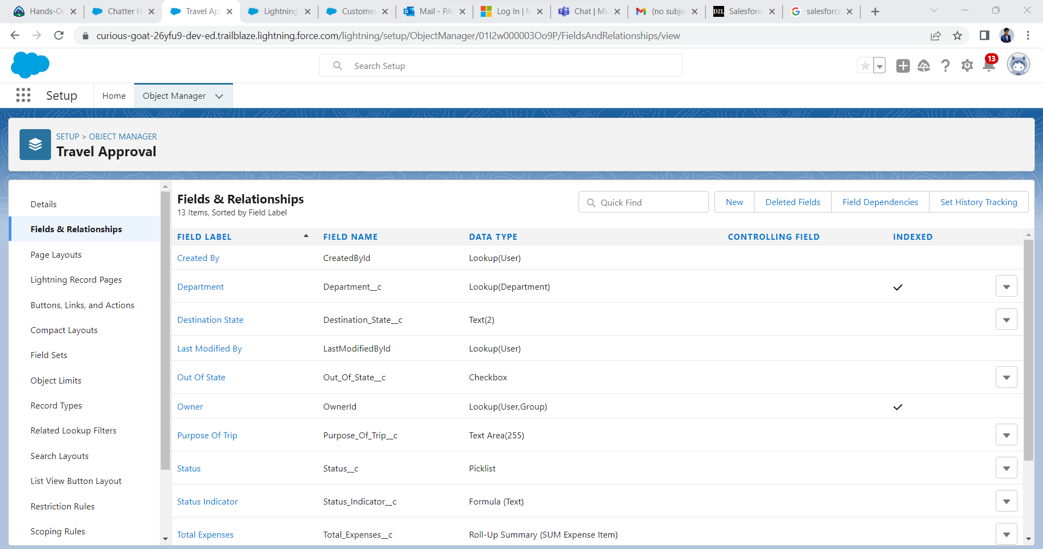

Slide 12
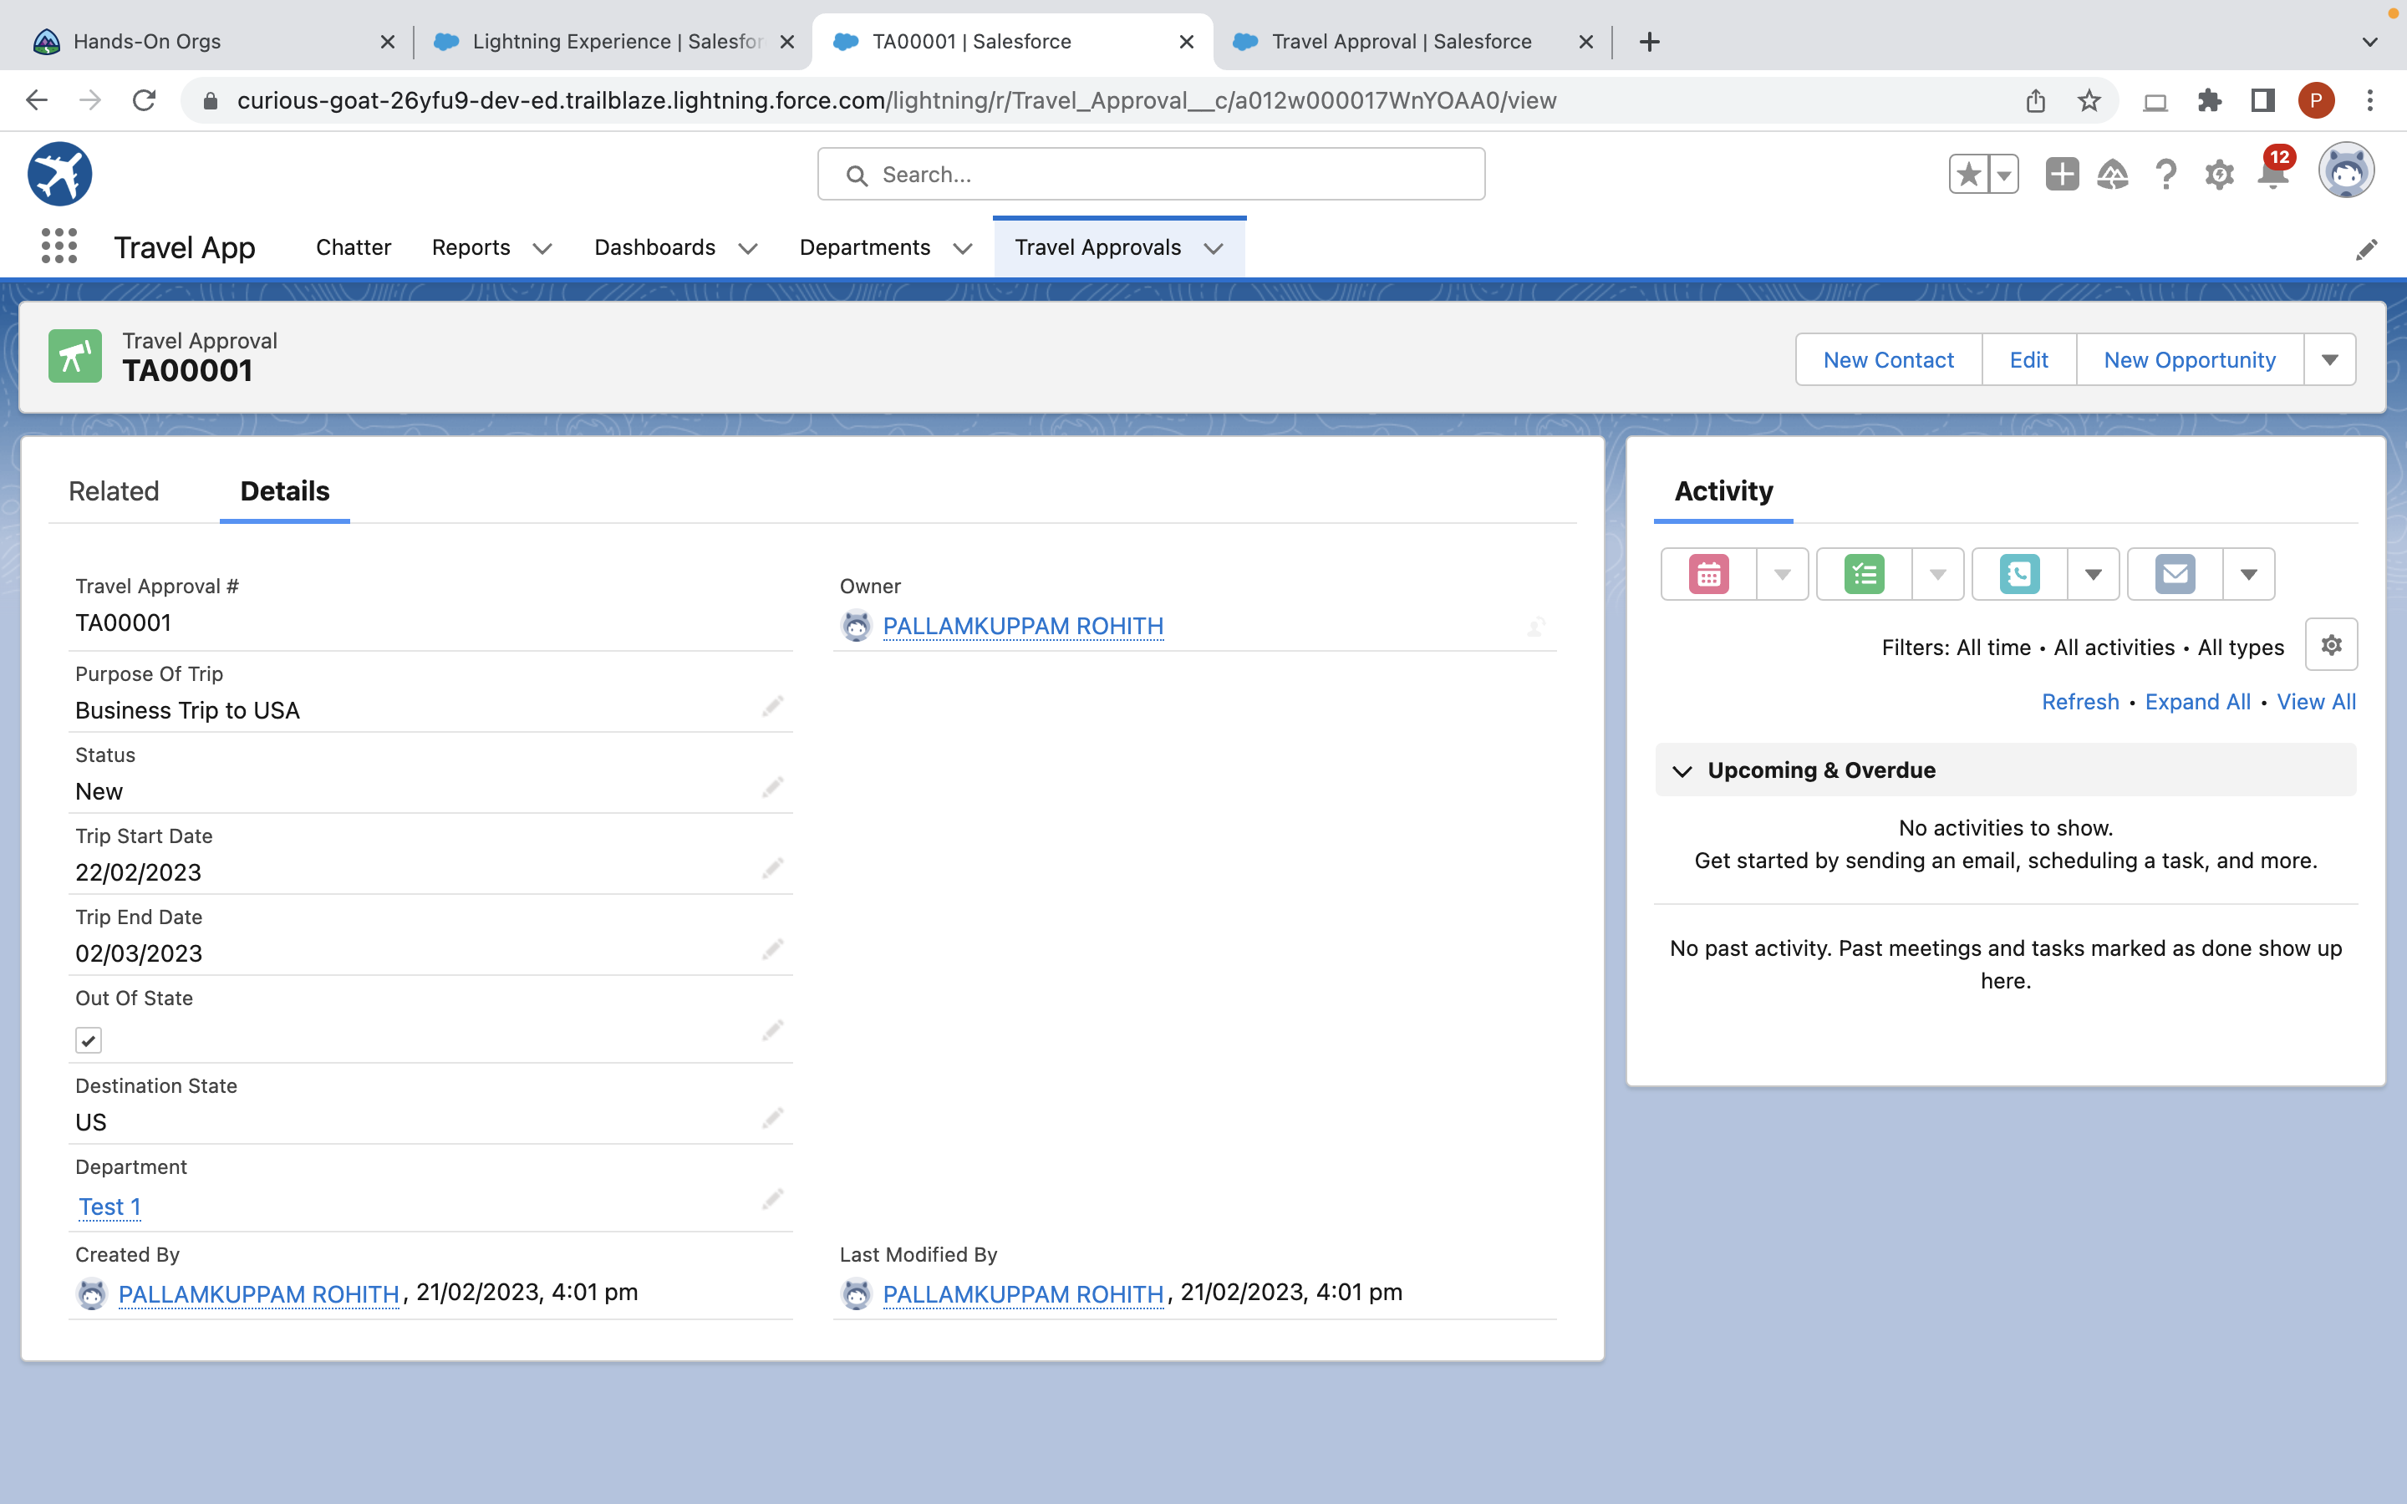

Slide 13
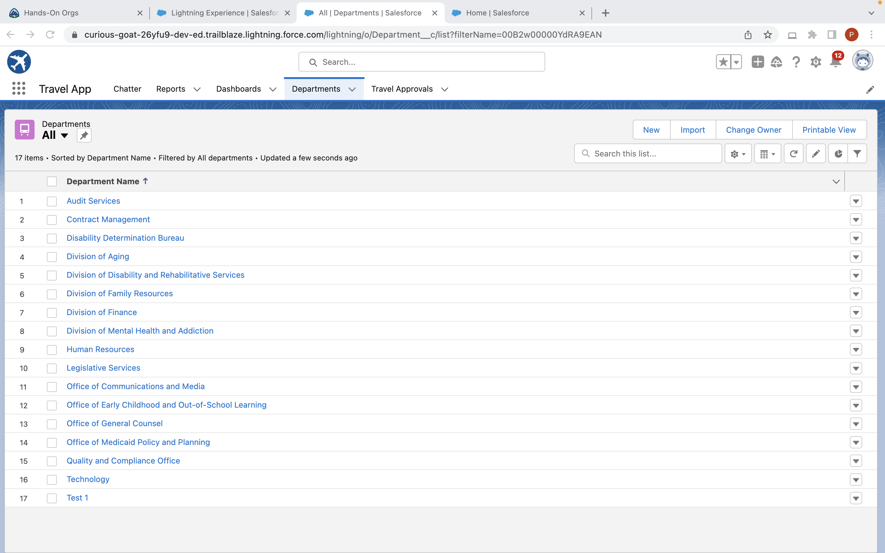

Slide 14


Slide 15
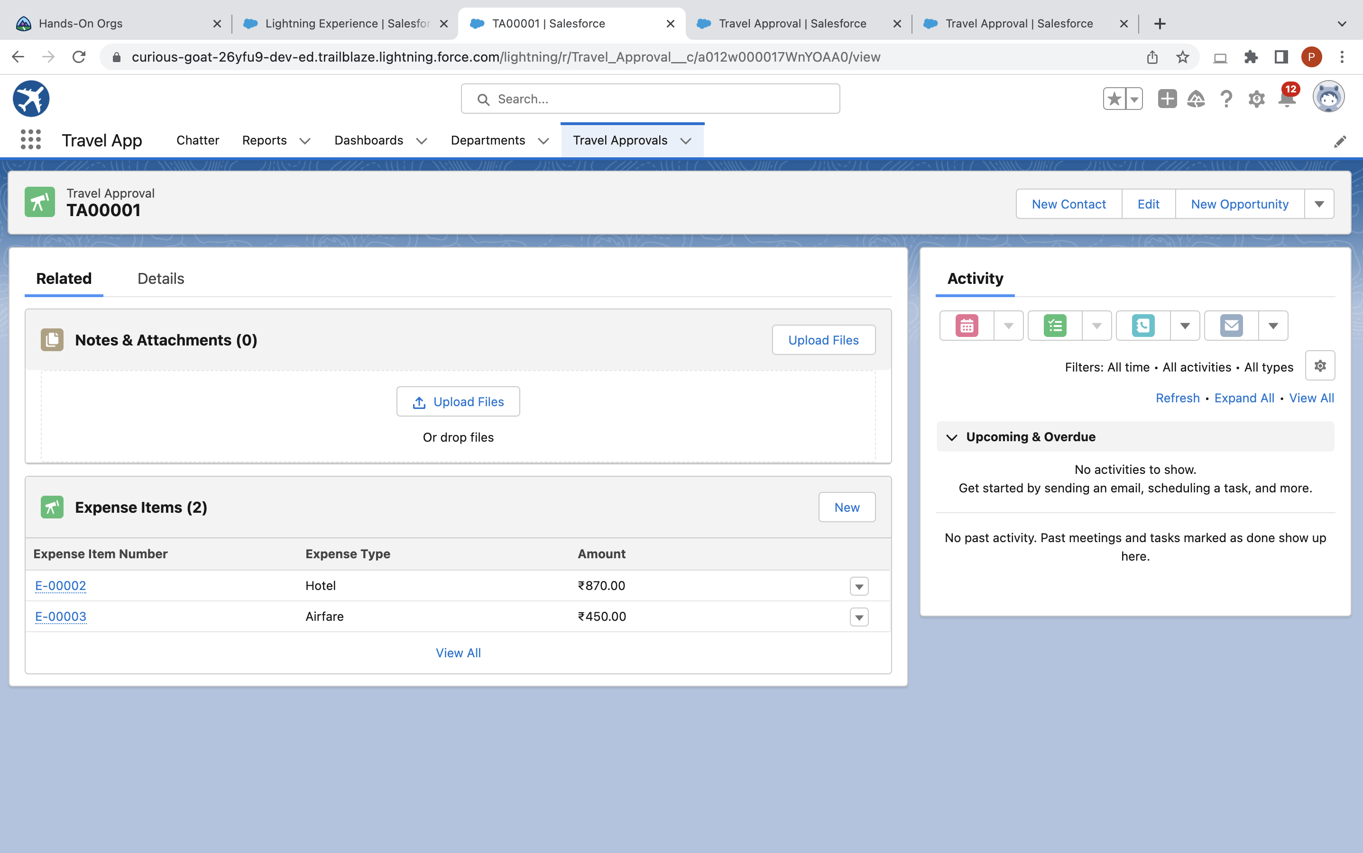

Slide 16
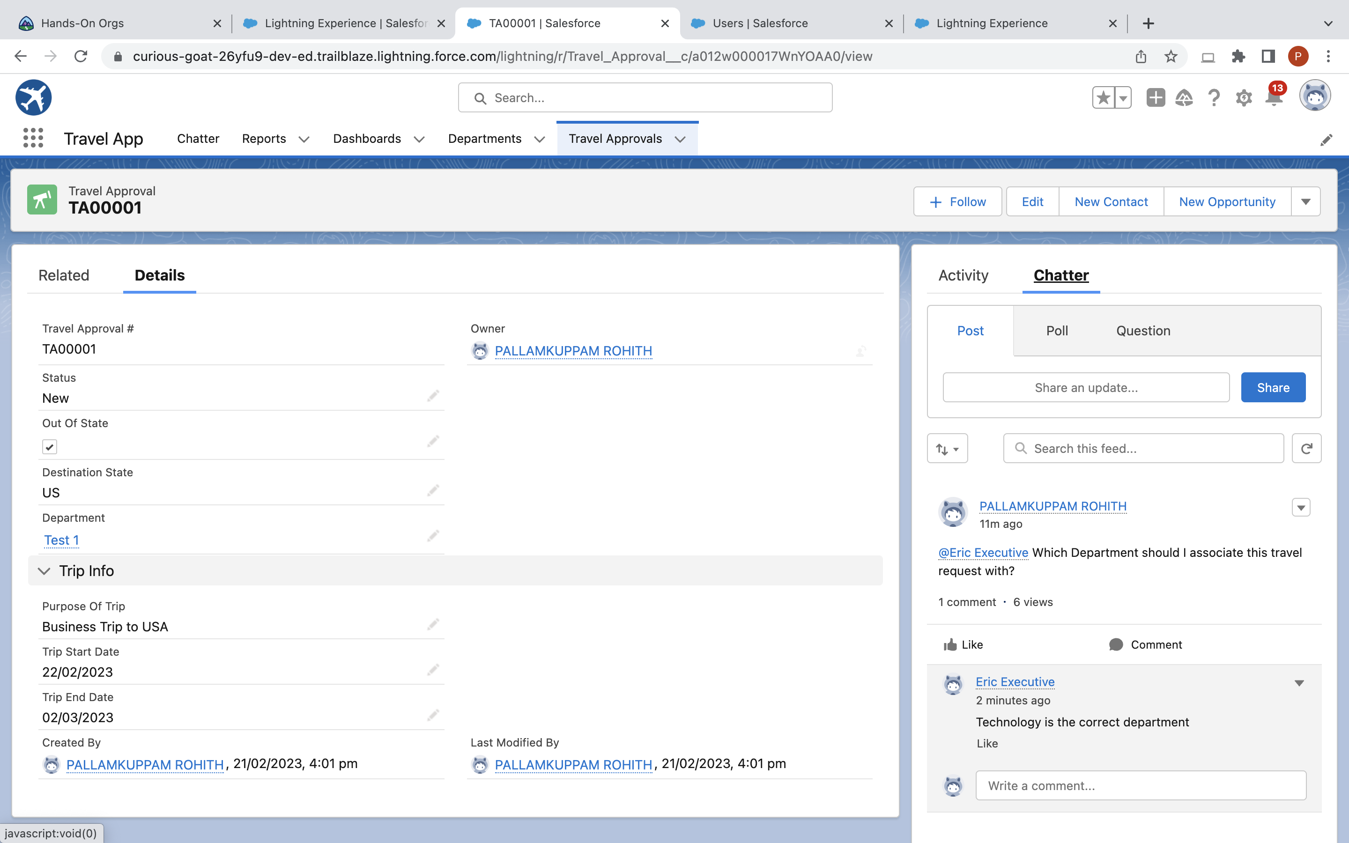

Slide 17
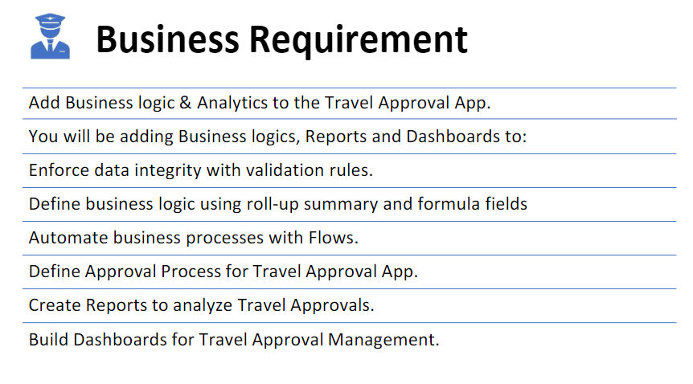
Module 2

Slide 18
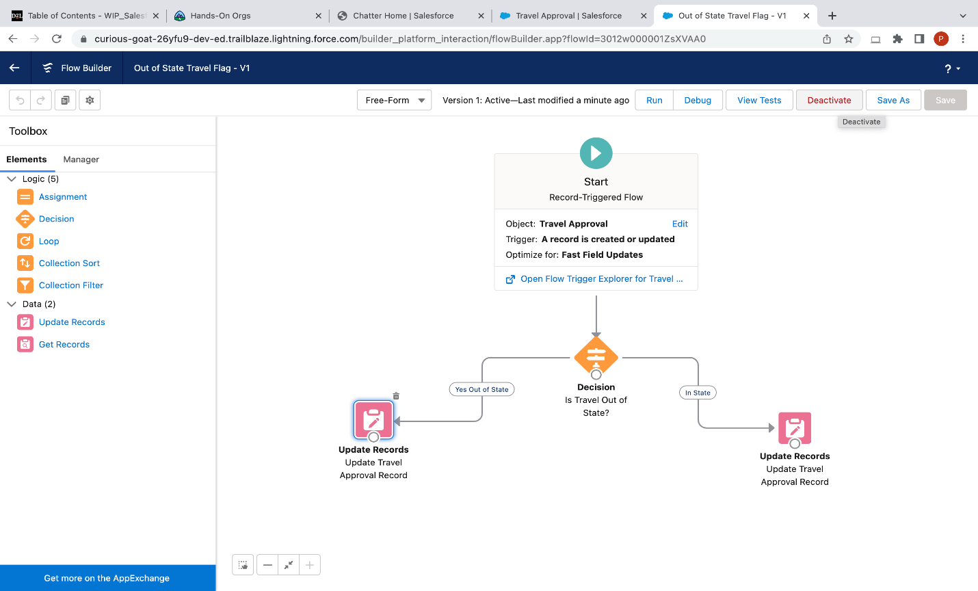

Slide 19
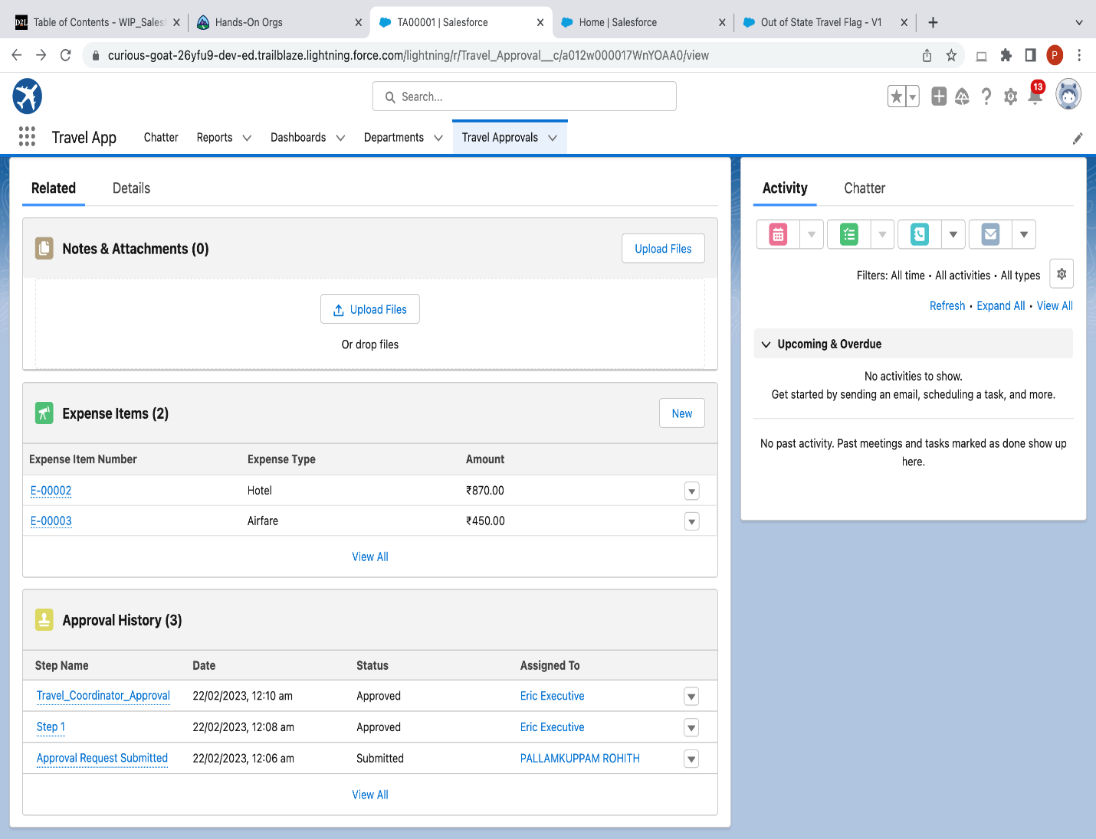

Slide 20
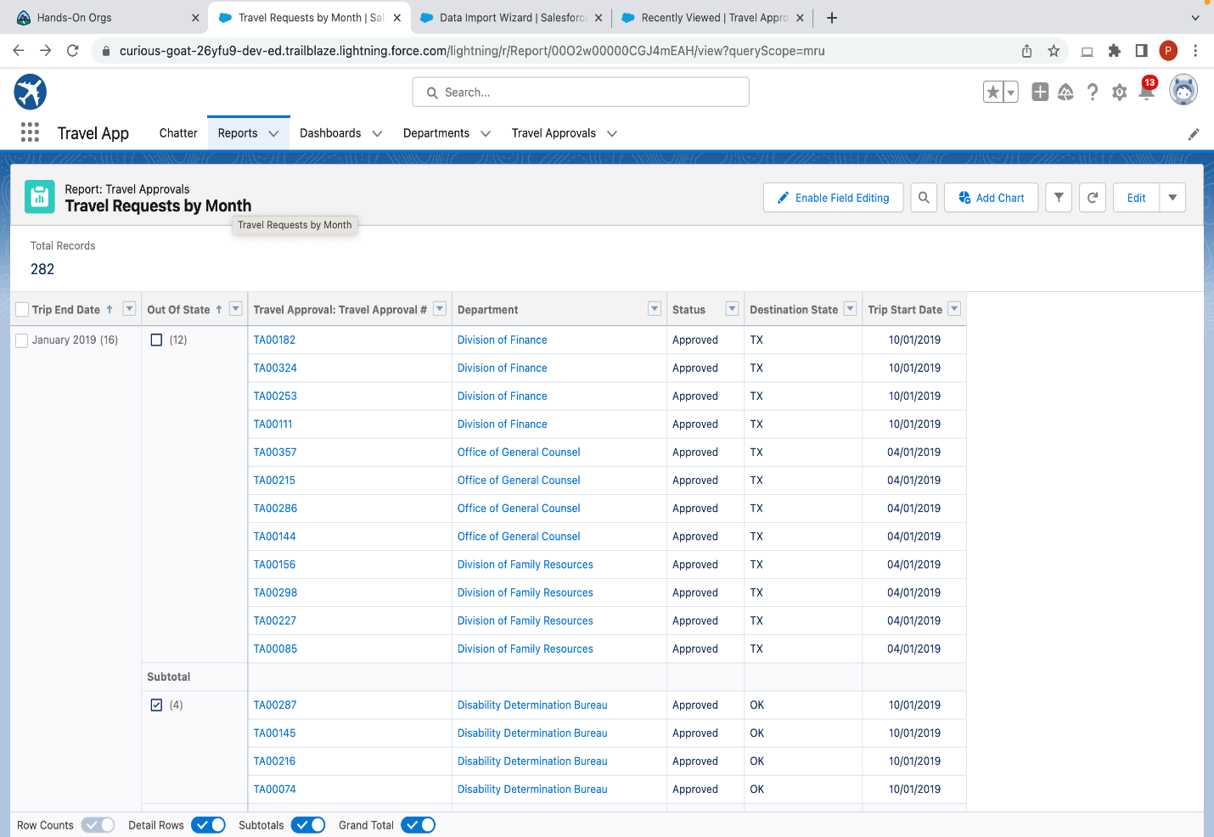

Slide 21
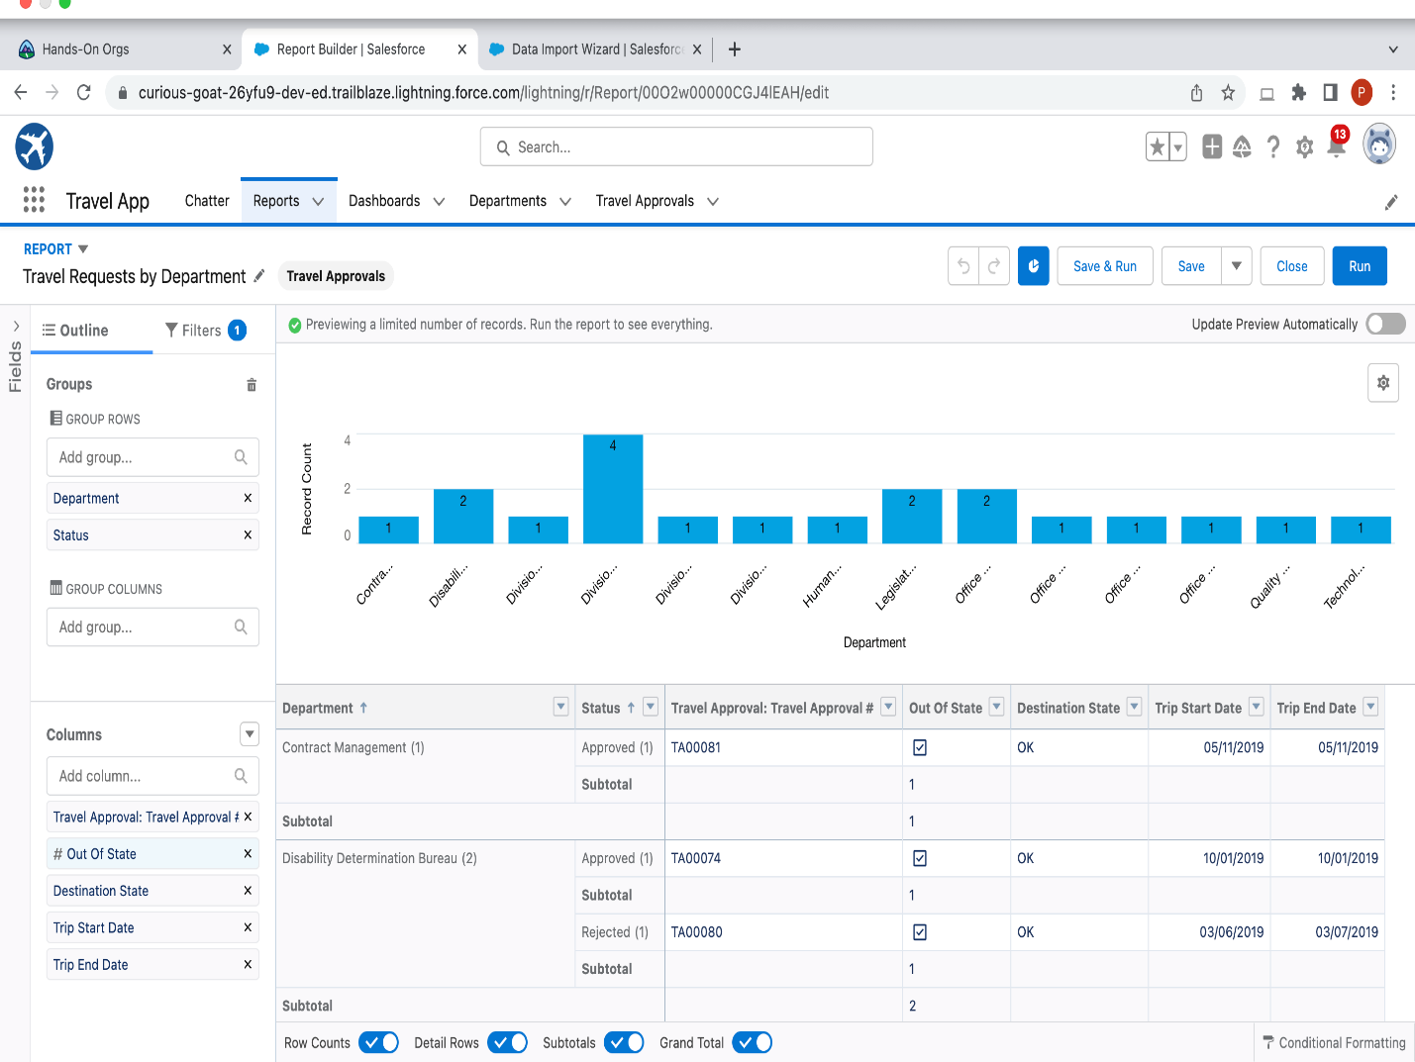

Slide 22
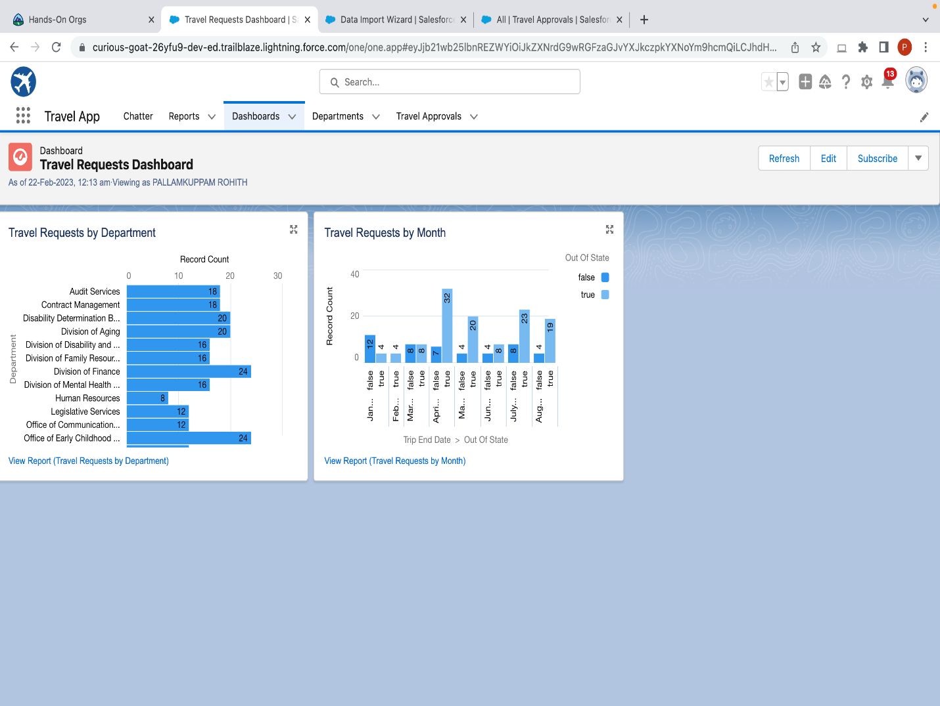

Slide 23
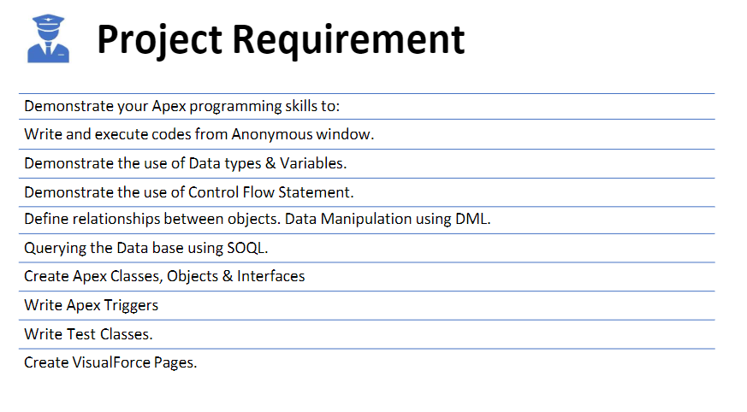
Module 3

